Slide 1


Bse3214: Cloud Computing and Big Data
Understanding data management in the digital age
Dynamic Interactions and Computing Architectures
Notes:
- Applied Human Machine Intelligence

Slide 2
In LAST Lecture
Overview of cloud computing: History, and Characteristics
Service & Deployment models (IaaS, PaaS, SaaS), Infrastructure, and Consumer View
Advantages and challenges of cloud computing

Slide 3
In THIS Lecture
SaaS Interaction Dynamics and Software Stack Control
SaaS Benefits, Issues and Concerns, Suitability, and Recommendations
PaaS Benefits, Issues and Concerns, Suitability, and Recommendations

Slide 4
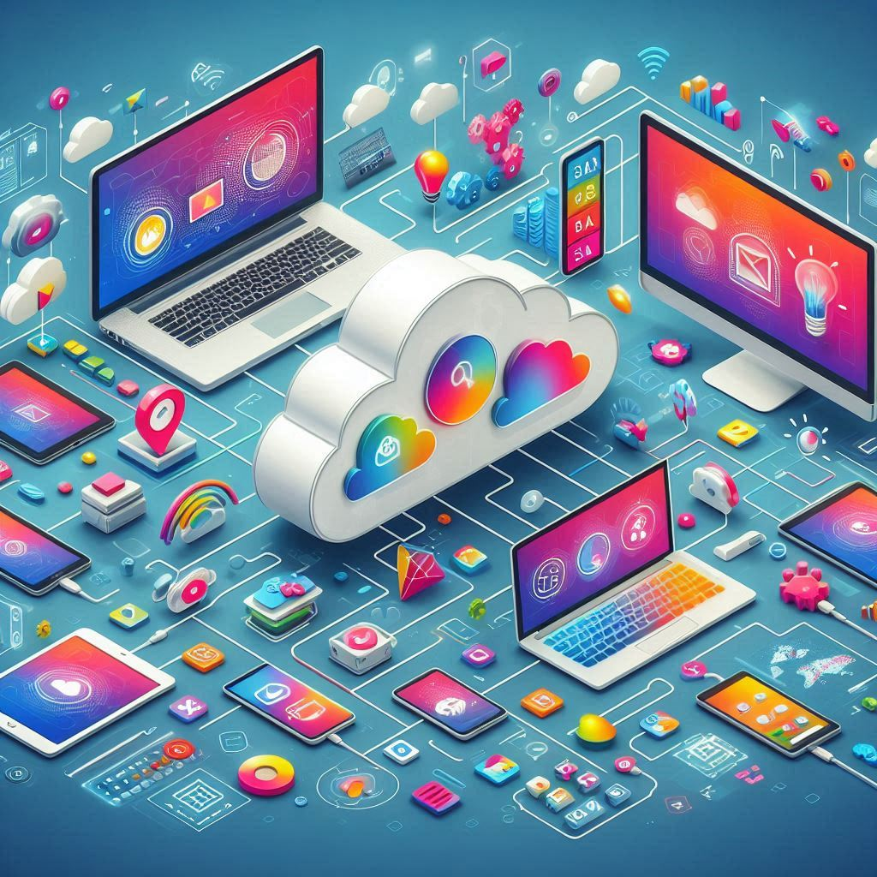
Software as a Service (SaaS) Interaction Dynamics
SaaS is Cloud-based software delivered via the internet, hosted by a service provider.
Key components: Application, database, integration, and security layers.
Users access SaaS apps through browsers or APIs.
SaaS eliminates local installations, offers scalability, and reduces infrastructure costs
Notes:
Google Workspace provides SaaS applications like Gmail and Google Docs.

Slide 5
Software Stack Control in SaaS
SaaS providers manage the entire stack from infrastructure to application layers.
Users control application configurations and data but not infrastructure
Provider Responsibilities: Security, maintenance, and updates.
Notes:
In Salesforce, users customize reports and interfaces, but Salesforce manages servers and databases.
- This setup is ideal for organizations that want to avoid hardware management.

Slide 6
SaaS Benefits
Cost-Effective: Pay-as-you-go pricing, no upfront investments
Scalability: Easily scale resources based on demand.
Accessibility: Access from any device with an internet connection.
Automatic Updates: SaaS providers handle software updates.
Notes:
Dropbox offers storage solutions for small businesses without requiring on-site hardware.
As their needs grow, they simply upgrade the subscription.

Slide 7
SaaS Issues and Concerns
Integration Challenges: Connecting SaaS with legacy systems can be complex.
Security Risks: Storing sensitive data on the cloud can raise privacy concerns.
Vendor Lock-in: Switching between SaaS providers can be difficult.
Data Sovereignty: Compliance with local data protection laws can be challenging.
Downtime: Dependency on provider’s uptime.
Customization: Limited modification options.
Compliance: Ensuring regulatory compliance.
Notes:
Migrating from Salesforce to another CRM might be challenging due to proprietary data formats.
Security risks and vendor lock-in are primary concerns when adopting SaaS solutions.

Slide 8
Evaluating SaaS Suitability
Assess Business Needs: Ensure SaaS aligns with organizational goals.
Evaluate Technical Requirements: Check compatibility with existing systems.
Cost Considerations: Compare SaaS pricing with on-premises alternatives.
Notes:
A healthcare provider might find Epic Systems a better fit for managing patient data in the cloud rather than an on-premise solution.

Slide 9
Recommendations for SaaS Adoption
Assess Business Readiness: Ensure readiness for SaaS adoption.
Evaluate IT Capabilities: Check infrastructure compatibility.
Plan Implementation: Develop a phased approach for adoption and training.
Notes:
A large organization adopting Office 365 may need to assess its network capabilities and provide adequate training for staff.

Slide 10
Scope and Control in Cloud Computing
Scope: Defines the services and resources available to users.
Control: Determines the level of management and customization available.
Public Cloud: Broad scope, limited control.
Private Cloud: Narrow scope, greater control.
Notes:
- Public cloud users have access to many services but little control over infrastructure. Private cloud users have greater control but fewer services.

Slide 11
SaaS Interaction Dynamics
User Interaction: Users access SaaS through browsers or APIs.
Multi-Tenancy: SaaS apps serve multiple users from a single instance.
Real-Time Data Sync: Collaboration features enable seamless workflows.
Notes:
SaaS applications like Google Docs allow real-time collaboration with multiple users accessing the same document simultaneously

Slide 12
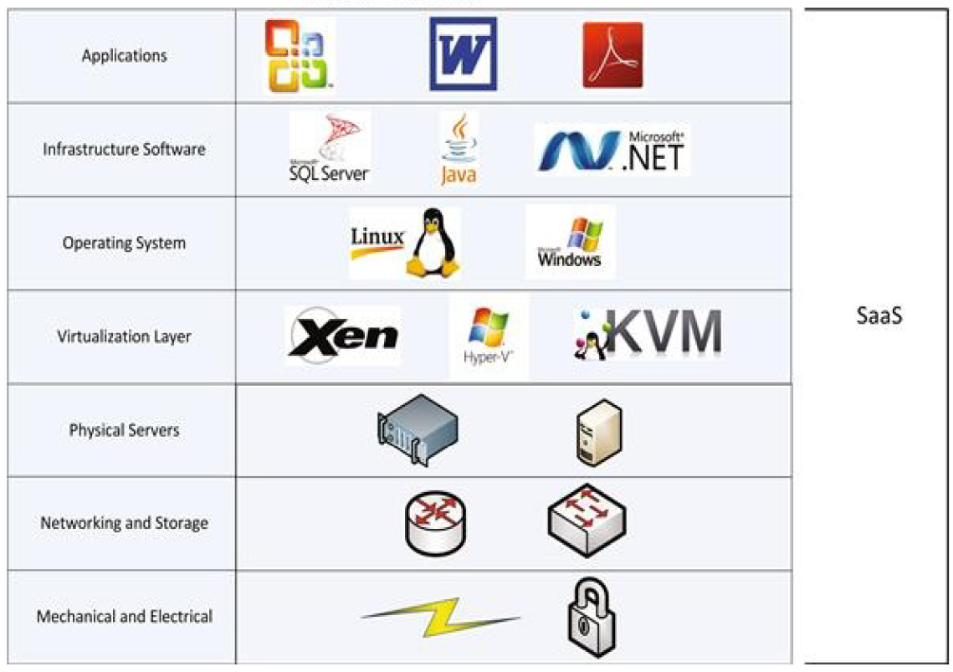
Software Stack Control in SaaS
Provider-Managed Stack: SaaS providers handle the entire software stack.
-Benefits: Reduced maintenance and automatic updates.
Challenges: Limited customization and vendor lock-in.
Notes:
With SaaS, the provider manages everything, so users only need to focus on configuring the application to their needs.

Slide 13

Saas usage case study: salesforce
Salesforce.com is a Customer Relationship Management (CRM) platform that integrates various business functions such as finance and customer service.
It offers tools for managing customer-related activities effectively.
The platform is customizable to fit various business needs.
Notes:
These activities could be related to:
sales (such as using customer information to generate future leads),
marketing tasks (like using historical sales data to develop sales strategies),
providing better customer service (by using call center data).
Salesforce.com provides a comprehensive list of features for all three of these types of activities.

Slide 14

Setting Up Salesforce for Your Business
First, obtain a Salesforce account for your organization.
System administrators customize the platform for your specific needs.
Import existing customer data to streamline operations.
Notes:
To begin using Salesforce, businesses must first secure an account.
The system administrator plays a vital role in customizing the platform to match the organization's workflow.
This includes importing existing customer data, ensuring a smooth transition and effective utilization of Salesforce's capabilities.
the system administrator belonging to the business has to import their existing customer data into Salesforce.com,
customize the various Salesforce.com screens, and give access rights for the appropriate screens to the employees of the business.

Slide 15

Customer Support Features of Salesforce
Access the Call Center Web page for managing customer requests.
Record calls and assign cases to support personnel.
Generate reports to track customer complaints and solutions.
Notes:
The Call Center Web page in Salesforce is essential for customer support representatives. It provides functionalities such as call recording, case assignment, and solution searching, enabling representatives to manage customer interactions efficiently.

Slide 16
Navigating the Salesforce Interface
Use the Cases tab to track and handle customer complaints.
Search functionality helps in quickly locating specific cases.
Mass Email tool facilitates communication with customers.
Administrators can add custom fields to case records.
Utilize picklists for easy data entry and selection.
Tailor the interface to meet specific user requirements.
Notes:
Navigating Salesforce's interface is user-friendly, especially with the Cases tab, which allows support representatives to manage customer complaints effectively. The search functionality and Mass Email tool enhance the overall efficiency in handling customer interactions. This slide focuses on the operational aspects of the platform.
Customization is a significant advantage of Salesforce. Administrators have the ability to add fields to case records, enhancing data relevance and accessibility. The use of picklists simplifies data entry, making it easier for users to interact with the platform. This slide highlights the flexibility of Salesforce in catering to unique business needs.

Slide 17
Conclusion
SaaS Benefits
- Cost Effective
- Scalable
- Highly accessible
- Automatic Updates
SaaS issues
- Integration challenges
- Vendor lock-in
- Security risks
- Data Sovereignty
Interaction Dynamics
- Access through APIs & Browsers
- Multi-tenancy
- Real-time data sync

Slide 18
Platform as a Service (PaaS)
Notes:
As cloud computing continues to evolve, it is important to recognize its limitations and challenges. This section will provide practical recommendations for consumers.

Slide 19
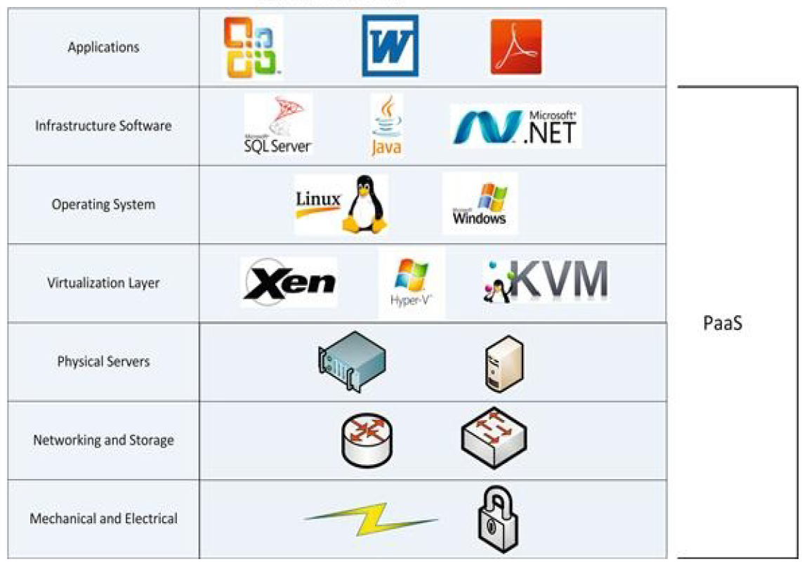
Paas: Overview
PaaS provides a versatile platform for various computing needs.
It often serves as a development environment for applications.
Platforms may include operating systems or full development stacks.
PaaS includes tools for application development and deployment.
Provider generally has no control over how the application or service is developed or over the quality of development.
Notes:
Platform as a Service (PaaS) is a cloud computing model that provides customers with a platform for their computing needs, primarily for development.
This can range from a simple operating system to a comprehensive development platform that includes web servers and libraries.
PaaS enables developers to focus on building applications without worrying about underlying infrastructure.
It abstracts infrastructure management, allowing focus on development.

Slide 20
PaaS Interaction Dynamics
Customization: Client has complete control over the application but not over deployment environment.
Analytics: Client has ability to view application usage and determine trends.
Integrations: data will be stored at the provider site, but the client will have direct access to it.
Responsibilities are shared between client and PaaS provider
Notes:
Analytics
You will be able to see which components are getting the most use and which ones are not being used.
In a PaaS environment, you will also usually have visibility into the use of the platform. You will be able to determine when new systems need to be added to handle the load. Often, providers give you the ability to automatically spin up new systems when your current ones meet certain load thresholds.
Integration
. Conducting business intelligence and
reporting should not be a problem from an access point of view, but you could
run into issues when it comes to bandwidth usage, because you may be moving
large amounts of data between your internal environment and the provider’s
environment. So there might be performance concerns there, as opposed to
access or functionality concerns.
In a PaaS implementation, the customer is generally responsible for
everything above the operating system and development platform level
The
database platform may be supplied for you, but you will be responsible for the
data.

Slide 21

Benefits of PaaS
Accelerates application development and deployment processes.
Reduces operational costs by minimizing infrastructure management.
Facilitates collaboration among development teams.
Notes:
There have been many drivers influencing the growth of the PaaS market. Many
organizations want to move towards a public cloud model, but can’t find public
SaaS providers offering the applications they need. A PaaS model allows them to
move the infrastructure and platforms out of their internal datacenters while
allowing them to be able to develop the applications they need.

Slide 22

Challenges of PaaS
Potential for vendor lock-in with specific platforms.
Limited control over the underlying infrastructure.
Security concerns regarding data management.
Notes:
One significant concern is vendor lock-in, which occurs when users become dependent on a specific provider's platform.
Additionally, users have limited control over the underlying infrastructure, which can impact performance.
Security is another critical issue, as storing and processing data in the cloud raises concerns about data management and compliance. Since the provider has direct access to the systems, they will have direct access to all of the applications and data.

Slide 23
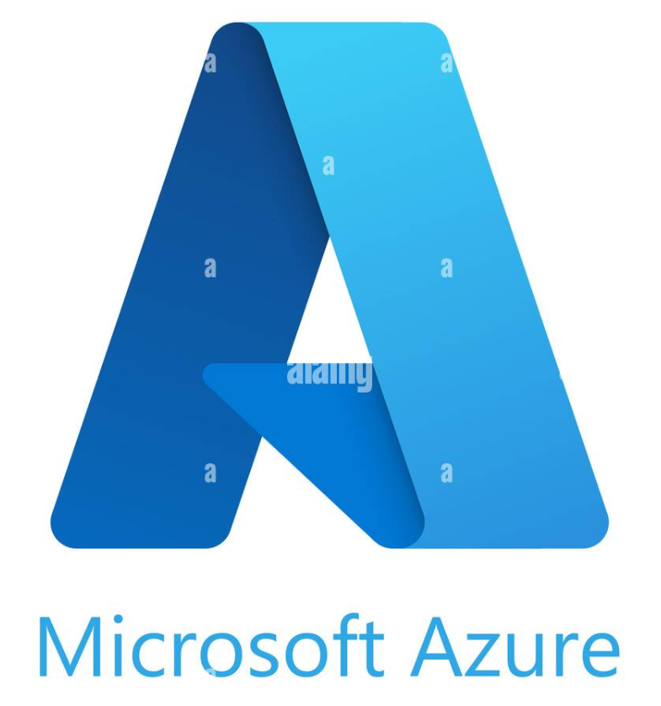

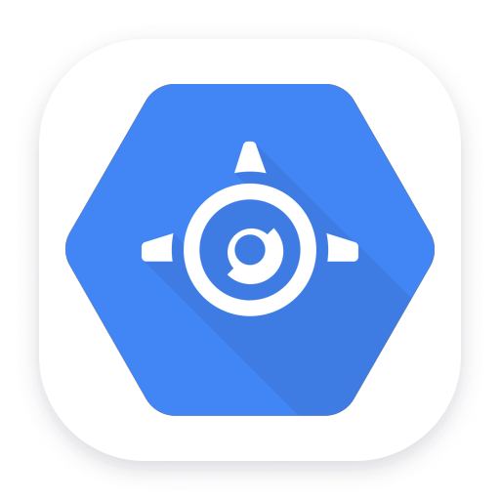
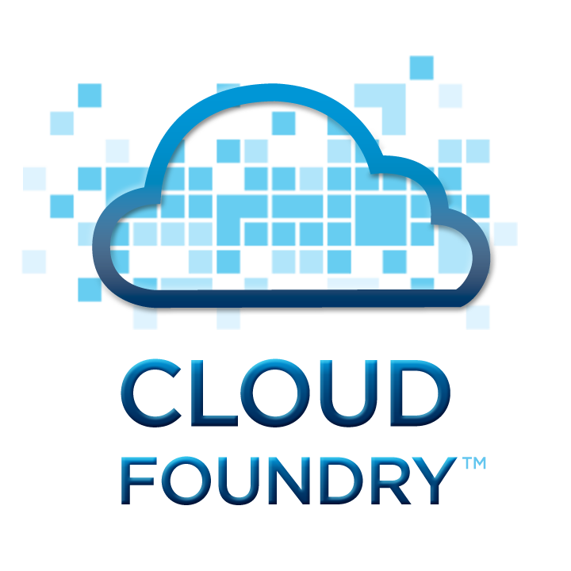
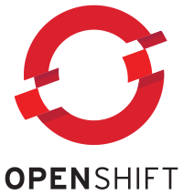
Major PaaS Providers
Google App Engine offers scalable web applications and mobile backend services.
Microsoft Azure provides a wide range of cloud services for app development.
Heroku is a popular PaaS for deploying, managing, and scaling applications.
IBM Cloud Foundry focuses on enterprise solutions with robust security features.
Red Hat OpenShift is an open-source platform for containerized applications.
Heroku
Notes:
This slide covers several major PaaS providers that are essential in today’s cloud ecosystem. Google App Engine is known for its scalability. Microsoft Azure offers a diverse set of services, while Heroku simplifies app deployment. IBM Cloud Foundry provides enterprise security, and Red Hat OpenShift focuses on containerized applications, showcasing the variety of solutions available in the PaaS market.
Google App Engine is a PaaS solution that enables users to host their
own applications on the same or similar infrastructure as Google Docs,
Google Maps, and other popular Google services. Just as Microsoft
Azure provides a platform to build and execute .NET applications,
Google App Engine enables users to develop and host applications
written using Java, Python, and a new language called Go.6 The
platform also supports other languages that use Java Virtual Machine
(JVM) runtime, such as JRuby, JavaScript (Rhino), and Scala
programming languages.
Google App Engine allows a newly developed application to be
served from the developer’s own domain name. For example, if the
developer chooses myapp as an application name, the application will
be served at http://myapp.appspot.com. This URL can be shared
publicly or selectively shared with a small group of members. Every
developer can host up to 10 applications for free,

Slide 24
Infrascructure as a Service (IaaS)

Slide 25
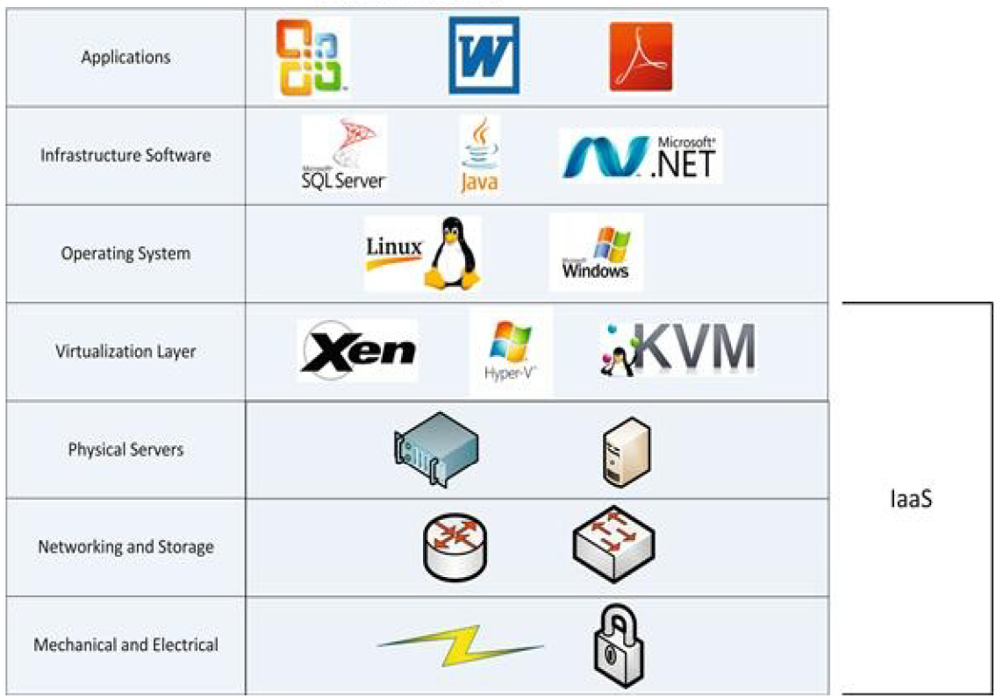
iaas: Overview
IaaS provides core services such as computing power, storage, networking, and operating systems.
IaaS providers typically provide virtual machines that you can use to install whatever you need
Notes:
An IaaS provider may provide you with hardware resources such as servers
You could then install whatever you needed to onto the servers.
This can be costly, though, because the provider would not be able to make use of multitenancy or economies of scale.
Because the systems are virtualized, the provider is able to take advantage of multitenancy.
These systems can host many different customers on the same set of physical hardware

Slide 26
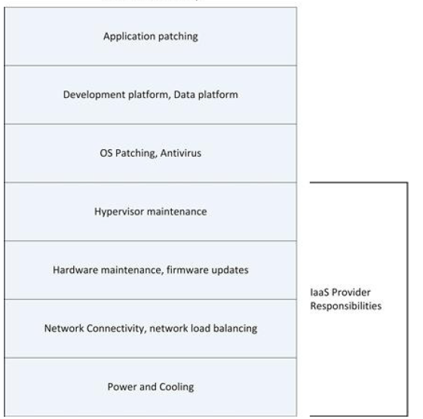
iaaS Interaction Dynamics
Responsibilities: Client is responsible for most of the environment: OS, Apps, Antivirus etc.
Notes:
The provider is responsible for the hypervisor layer (if used) and below.
This includes physical hardware, storage, and networking.
The physical hardware will be stored in the provider’s datacenter, but the customer may have full access to it.

Slide 27

Advantages of Infrastructure as a Service (IaaS)
IaaS provides on-demand computing resources, allowing for flexibility.
Reduces the need for physical hardware and maintenance costs.
Users can easily scale resources up or down based on demand.
Pay-as-you-go pricing models help manage budgets effectively.
Enhances disaster recovery solutions with cloud-based backups.
Notes:
Infrastructure as a Service (IaaS) offers numerous benefits such as flexibility in resource management, reduced costs for physical hardware, and scalability according to the needs of the business. Additionally, IaaS allows organizations to adopt a pay-as-you-go pricing model, making budgeting more manageable. It also provides enhanced disaster recovery options through cloud-based solutions, ensuring business continuity.
Instead of
spending a lot of money expanding a datacenter or building a new datacenter,
organizations are basically renting systems provided by an IaaS provider.
Organizations are also looking at IaaS providers to provide burst capacity.
Some organizations need increased capacity only on certain occasions. For this
reason, they don’t want to spend money on costly permanent solutions. An IaaS
provider customers them to add capacity on a temporary basis. With IaaS,
customers pay for the increased capacity only when they need it.

Slide 28
Challenges of Infrastructure as a Service (IaaS)
Security vulnerabilities can arise due to shared infrastructure.
Managing and configuring virtual machines requires specialized knowledge.
Potential for unexpected costs if usage is not monitored closely.
Dependence on the service provider for uptime and reliability.
Compliance with regulations can be complex and challenging.
Notes:
While IaaS provides flexibility and scalability, there are challenges that users must navigate. Security vulnerabilities may occur due to the shared nature of infrastructure. Additionally, managing virtual machines demands expertise, and unexpected costs can arise without diligent monitoring. Users also depend on service providers for uptime, which can affect reliability, and navigating compliance with regulations can be complex.
Most organizations see the benefits, but they worry about the loss of control.
The total cost can also be an issue. In many IaaS environments, you are charged for resource usage, such as
processor and memory. Unless you carefully monitor your system usage, you
may be in for a shock when the bill comes.

Slide 29
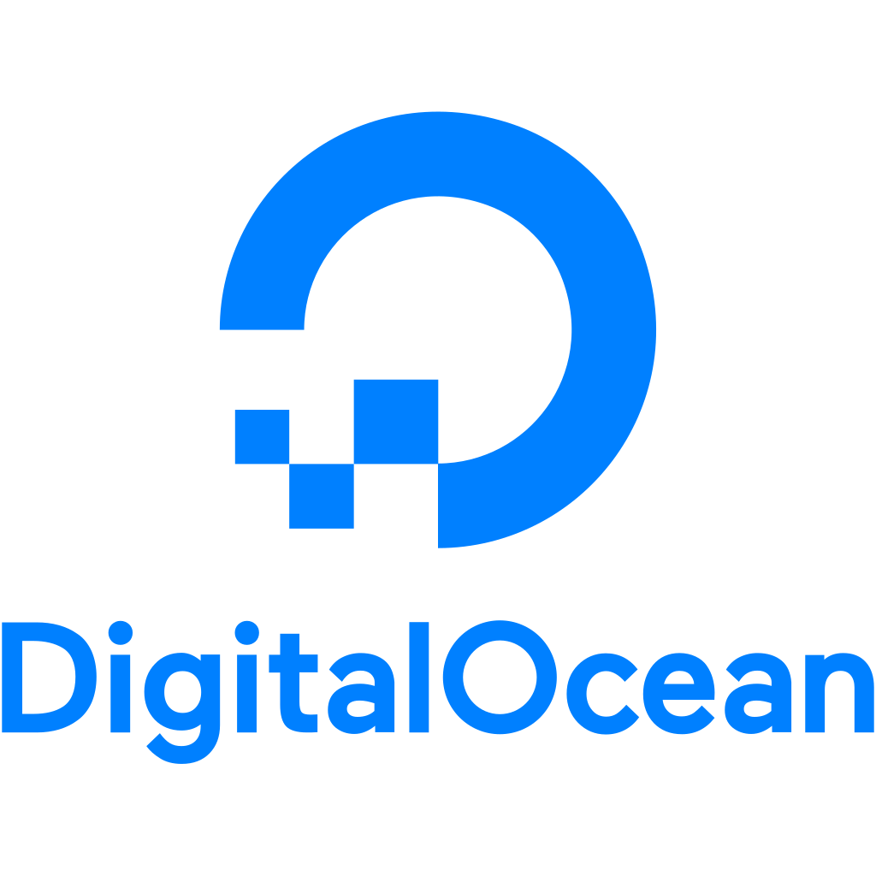
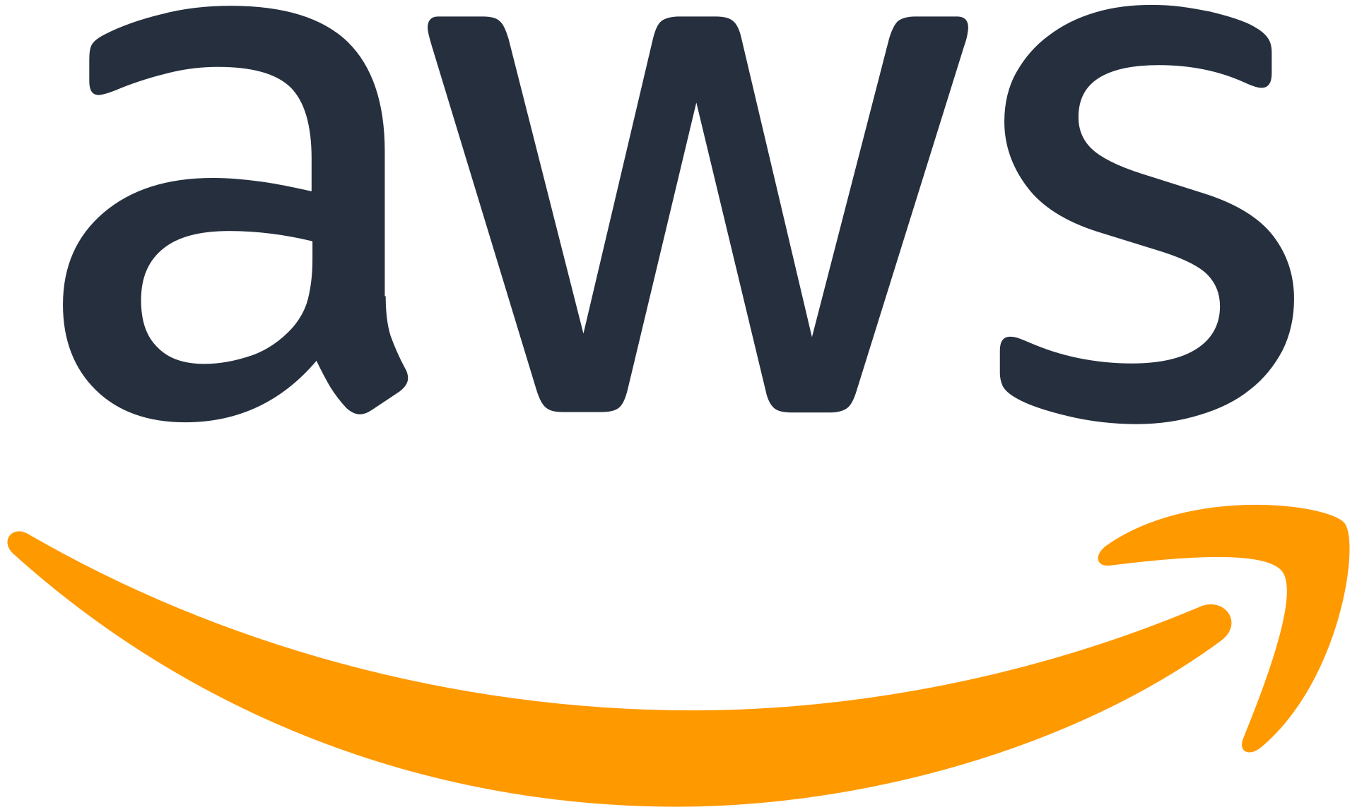
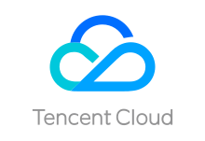
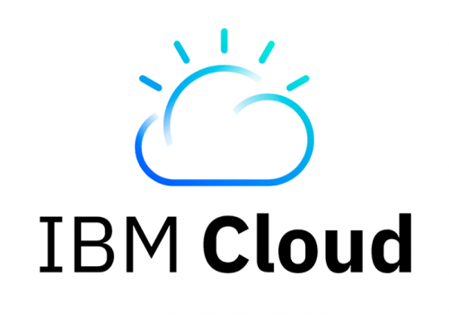

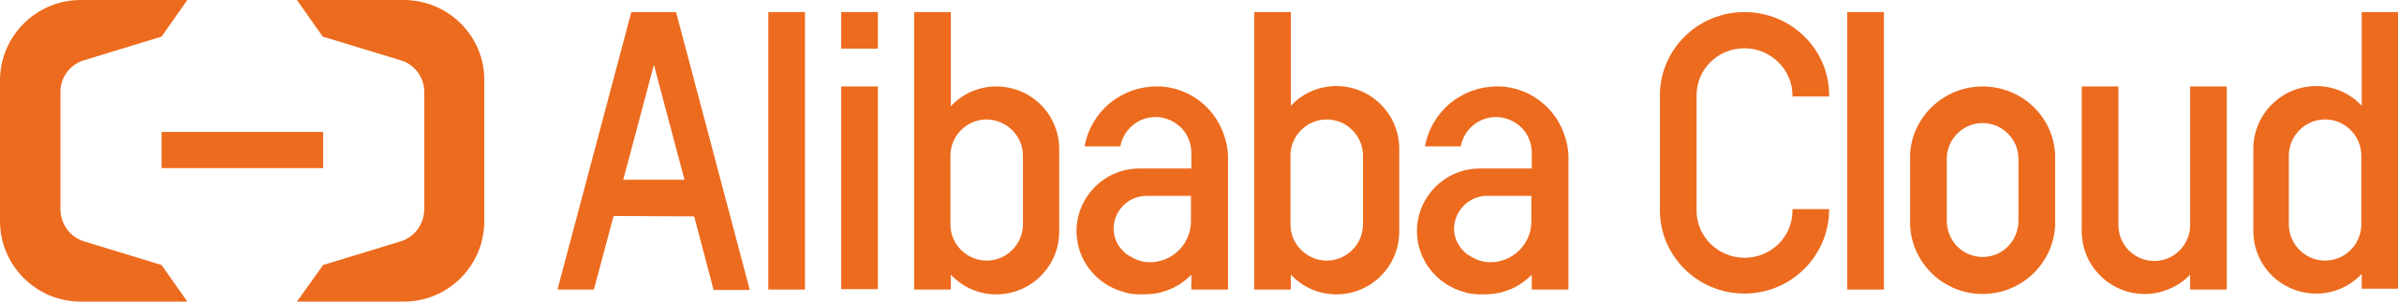
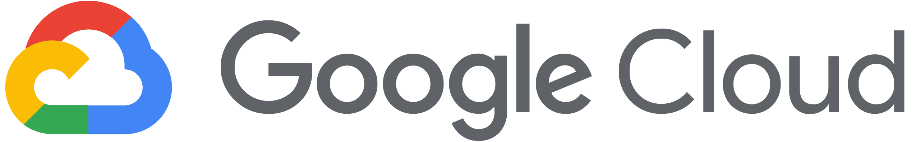
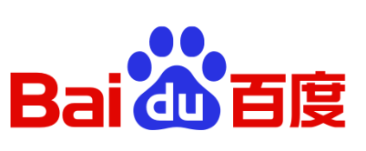
Leading Players in IaaS Market
Amazon Web Services (AWS) offers a comprehensive cloud infrastructure (about 32% market share).
Microsoft Azure provides a wide range of services for various applications (About 21% market share).
Google Cloud Platform focuses on data analytics and machine learning capabilities (7% market share).
IBM Cloud offers enterprise solutions with strong security features (6% market share).
DigitalOcean is popular among developers for its simplicity and cost-effectiveness.
Notes:
The IaaS market is competitive, with several major providers leading the industry. Amazon Web Services (AWS) is recognized for its extensive services, while Microsoft Azure and Google Cloud Platform emphasize integration and data analytics. IBM Cloud targets enterprises with robust security options, and DigitalOcean caters to developers with straightforward pricing and ease of use. This variety allows businesses to choose providers that best meet their needs.
The leading players in the Infrastructure as a Service (IaaS) market are:
1. **Amazon Web Services (AWS)**: Amazon's cloud computing platform offers a wide range of IaaS services, including virtual machines, storage, databases, and more.
2. **Microsoft Azure**: Microsoft's cloud computing platform provides a suite of IaaS services, including virtual machines, storage, networking, and hybrid solutions.
3. **Google Cloud Platform (GCP)**: Google's cloud computing platform offers a range of IaaS services, including virtual machines, storage, databases, and more.
4. **IBM Cloud**: IBM's cloud computing platform provides a suite of IaaS services, including virtual machines, storage, networking, and hybrid solutions.
These four companies are often referred to as the "Big Four" in the IaaS market due to their significant market share and influence.
Other notable players in the IaaS market include:
1. **Oracle Cloud Infrastructure**: Oracle's cloud computing platform provides a range of IaaS services, including virtual machines, storage, networking, and more.
2. **Rackspace**: Rackspace is a managed hosting company that offers a range of IaaS services, including virtual machines, storage, and networking.
3. **CenturyLink**: CenturyLink is a telecommunications company that offers a range of IaaS services, including virtual machines, storage, and networking.
4. **T-Mobile Business**: T-Mobile's business division offers a range of IaaS services, including virtual machines, storage, and networking.
The market share of the leading players in the IaaS market can be summarized as follows:
1. **Amazon Web Services (AWS)**: around 32% market share
2. **Microsoft Azure**: around 21% market share
3. **Google Cloud Platform (GCP)**: around 7% market share
4. **IBM Cloud**: around 6% market share
The IaaS market is highly competitive, with a range of new entrants and innovators disrupting traditional service providers.
Market Share Data:
Source: MarketsandMarkets Research Report, "Infrastructure as a Service (IaaS) Market by Solution, Service, Industry Vertical, and Geography - Global Forecast to 2027"
Note that the exact market share data may vary depending on the source and methodology used.

Slide 30
Key points
Infrastructure as a Service (IaaS): Provides virtualized computing resources over the internet.
Examples:
Amazon Web Services (AWS): offers virtual machines, storage, databases, and more.
Microsoft Azure: provides virtual machines, storage, networking, and hybrid solutions.
Google Cloud Platform (GCP): offers virtual machines, storage, databases, and more.
Platform as a Service (PaaS): Provides a complete platform for developing, running, and managing applications.
Examples:
Heroku: provides a platform for building, deploying, and managing web applications.
Google App Engine: offers a platform for building scalable web applications.
Microsoft Azure App Service: provides a platform for building, deploying, and managing web applications.
Software as a Service (SaaS): Provides software applications over the internet.
Examples:
Salesforce: offers customer relationship management (CRM) software.
Microsoft Office 365: provides productivity software, including Word, Excel, PowerPoint, and more.
Dropbox: offers cloud storage for files.

